Slide 1
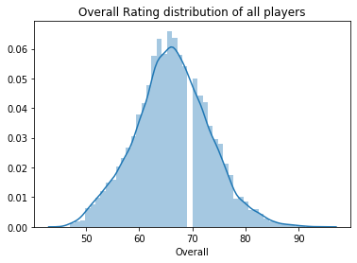
1.Plot the distribution of Overall rating for all players.
INFERENCE:-RIGHT SKEWED FIFA DATASET

Slide 2
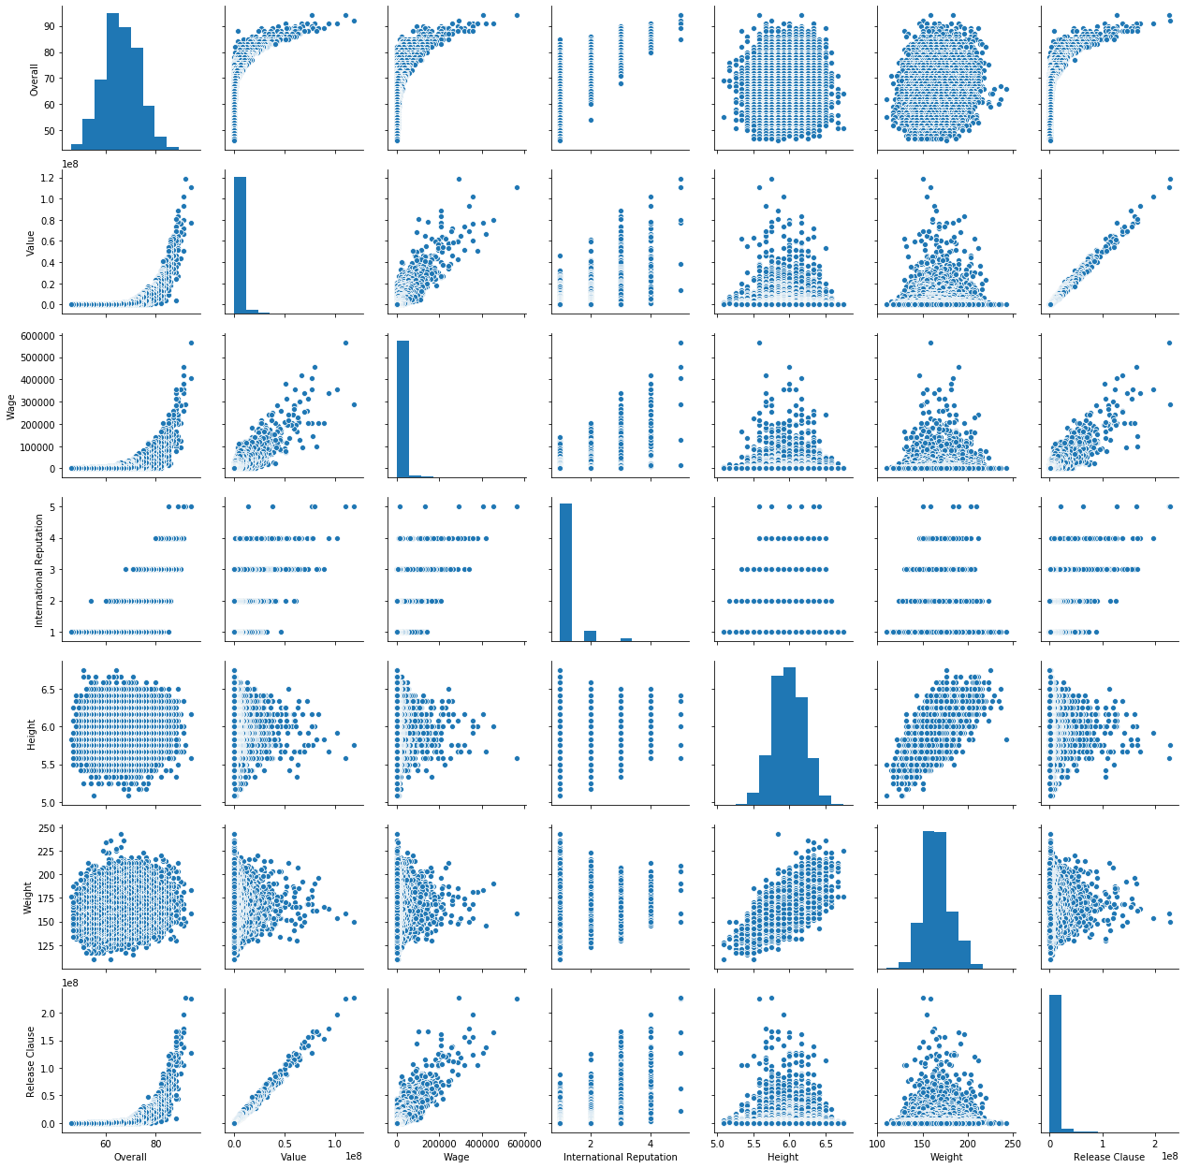
2.Generate pair plots for the following variables:
Overall, Value, Wage, International Reputation, Height, Weight, Release Clause
INFERENCE:-PAIRPLOT

Slide 3
3.Generate a table containing the top 20 players ranked by Overall score and whose contract expires in 2020.
What would the average wage for this set of players be?
The average wage of top 20 players whose contracts expire in 2020 is: 205450.0 Euros
b)What is the average age?
The average age of top 20 players whose contracts expire in 2020 is: 30.65
c)Is there a correlation between the Overall rating and Value for these players?
Correlation between Overall and Value: 0.7867166042074153

Slide 4
4.Generate tables containing the top 5 players by Overall rating for each unique position.
Are there any players appearing in more than one Table. Please point out such players. By analysis we can find that there are no players appearing in more than one table
What is the average wage one can expect to pay for the top 5 in every position?
Average Wage for each positions:-
CAM : 174000.0 LCB : 162000.0
LCM : 184400.0 LM : 164600.0
LS : 92200.0 LW : 261000.0
LWB : 30000.0 RAM : 45400.0
RB : 155400.0 RCB : 231000.0
RCM : 240800.0 RDM : 105000.0
RF : 148000.0 RM : 131400.0
RS : 130400.0 RW : 202000.0 RWB : 44200.0 ST : 294000.0
LDM : 94200.0 LF : 121200.0
CB : 139600.0
CDM : 217000.0
CF : 47400.0
CM : 130600.0
GK : 192800.0
LAM : 19000.0
LB : 177200.0

